Slide 1
Alpha Persei
By Miracle, Isabella, Lin and Jenna

Slide 2
History/cultural relevance
Named for the Greek mythology hero, Perseus
Was first recorded by Ptolemy, the greek astronomer, in the 2nd century (I)
Called Hinali’i in Hawaii, it is believed to be the point when heaven and earth were separated
Consists of massive blue class B stars that formed together at around the same time and continue to move together through space(J)
Notes:
Isabella and Jenna
Although, there is no mythology specifically associated with Mirfak, Perseus the constellation does represent the Greek hero (Perseus) who decapitated Medusa. In addition, this constellation was one of the first to be catalogued in the 2nd century by a Greek astronomer known as Ptolemy. In native Hawaiian astronomy, this star is called, Hinali’i and represents a great tsunami which was thought to begin the separation of Maui.

Slide 3
Fun Facts!
Alpha Persei is a supergiant star entering the last stages of evolution
It is approx. 60 times the size of the Sun and 5,000 times more luminous(L)
Alpha Persei is 510 light years away from Earth
Walking at 4 mph, it would take you about 84,910,124,481 years
Mifrak, a star is located in the Perseus constellation, it is the brightest star in it’s constellation and ties with two other stars as the 33rd brightest star known(M)
Notes:
Miracle and Lin

Slide 4
Project Goals (J)
- Create a color magnitude diagram for the stars in the Alpha Persei cluster
- Create another visualization including data from the Sun
- Use a color map to differentiate between the stars in the cluster
- Use histograms to get a better gauge of how many stars fit into particular ranges for color magnitude and absolute magnitude
Notes:
Jenna

Slide 5
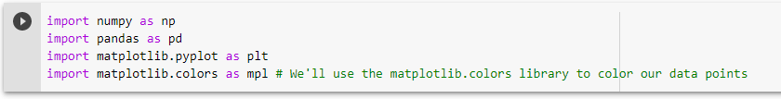
Why code? Why these libraries? (L)
Imported:
numpy
Matplotlib.pyplot
Pandas
Matplotlib.colors → give our graphs a range of color

Slide 6
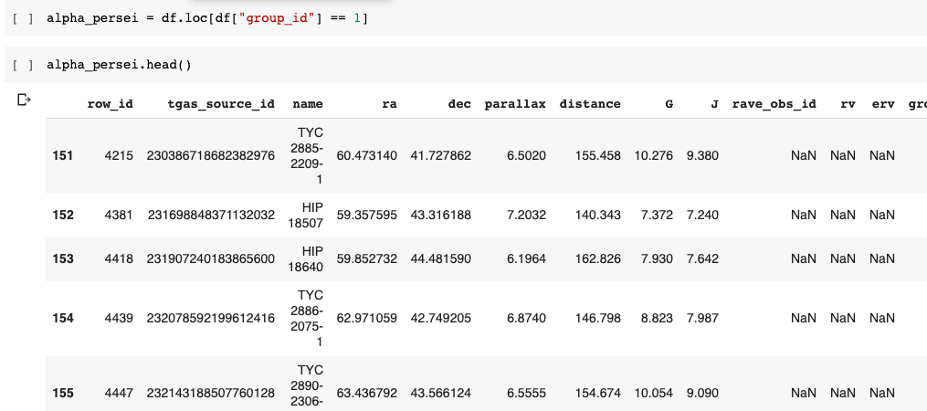
We want to display the conditional that is after df.loc which is group 1, and display all the values that a 1. Based on the group id, we want the display all the rows(I)

Slide 7
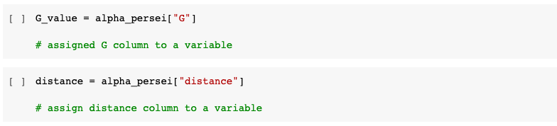
Assigned variables to the G column and distance column(M)

Slide 8
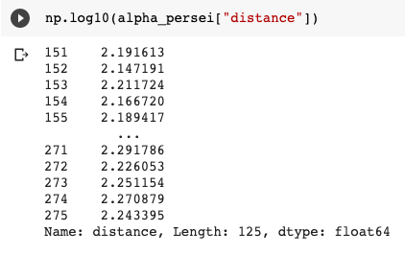
Here we used np.log10 to calculate the log of the distance for the following equation:
Absolute magnitude = G-5*log(distance)+5
(J)

Slide 9
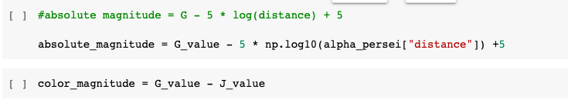
Created variables for absolute magnitude and color magnitude by substituting our information into their equations(L)

Slide 10
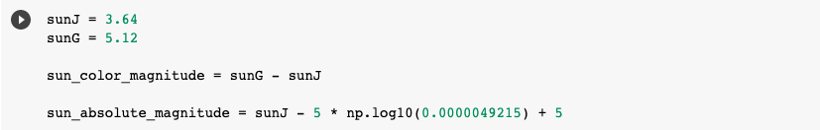
Assigned variables for the sun’s J and G values
Allowed us to graph the sun’s position in relation to the stars on our graph (M)
Sun’s distance in parsecs

Slide 11
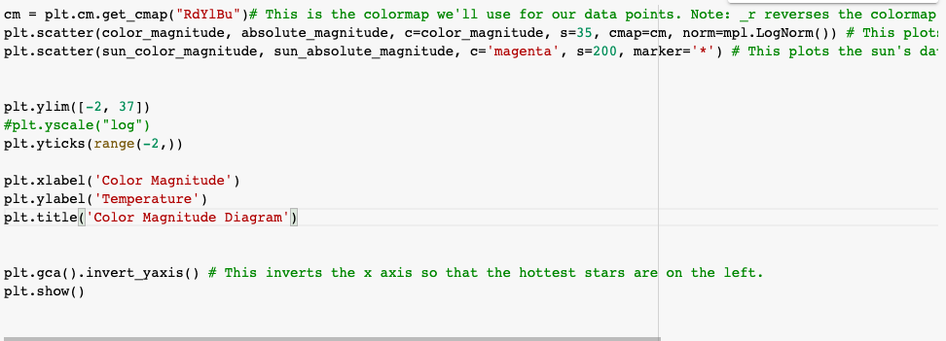
Coded the graph - x axis: color magnitude and y axis: absolute magnitude (J)
Graphed the sun (2nd line )
Notes:
Jenna !!!!

Slide 12
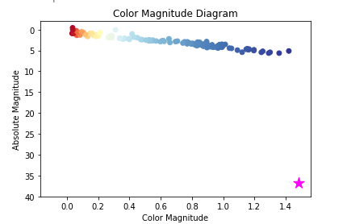
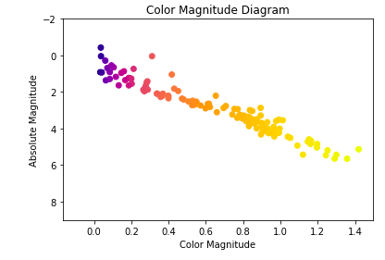
Visualizations (I)
Shows the stars, comparing their absolute magnitude to the color magnitude
Also compared the alpha persei stars to the sun
Depicted the color magnitude vs temp

Slide 13
Scientific Conclusions (M)
Our data shows that the star cluster has a lower absolute magnitude and a lower color magnitude than the Sun.
However, this indicates that the Alpha Persei star cluster is brighter than the sun because a lower absolute magnitude suggests a higher luminosity
Overall, the entire cluster had a high absolute magnitude and were blue in color

Slide 14
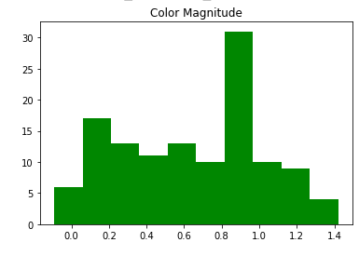
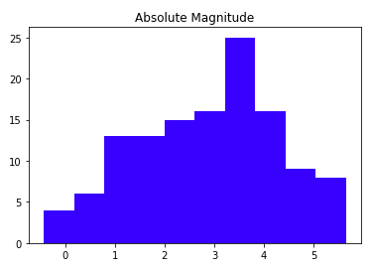
Histograms
The histograms show a range of values. It is for the color magnitude and the absolute magnitude for the star cluster. Using these histograms we can see how many stars fit into each range (J)

Slide 15
Challenges and Solutions (L)
Finding a plt.ylim range that fit our graph and the sun
Tried using the “plt.yscale(“log”) but it didn’t work → fixed the plt.ylim range instead
Struggled with the histograms. Struggled with the getting the right range and the number of bars
We changed the limits and adjusted the number based on the space between the number of stars

Slide 16
Next Steps (I)
To improve our current graphs, we could graph multiple star clusters to show the difference in luminosity from the sun with multiple stars. We could also plot the stars individually using a for loop to better visualize the data. The size of these stars could also be highlighted in different colors or markers to show their correlation with absolute magnitude.

Slide 17
Sources
https://www.universeguide.com/star/15863/mirfak
https://www.star-facts.com/mirfak/
https://osr.org/blog/astronomy/alpha-persei/
THANK YOU FOR LISTENING!

